Slide 1

RL-augmented MPC for Humanoid Robot Locomotion
Coletta Emanuele
Sartori Giulio
Sperduto Gianluca
Autonomous and Mobile Robotics
A.A. 2025/2026
Proff: Giuseppe Oriolo
Nicola Scianca

Slide 2
Table of contents
Introduction
LIP
General framework
State
Approaches
Reinforcement Learning
Disturbances
Reward
Approaches
Only first footstep
Full plan
Scaled actions
When Use Agent
Straight line with disturbances
Validation trajectory
Walking on the spot
Conclusions
Residual Detection
Hybrid Policy
Simulations
Straight line
ISMPC

Slide 3
INTRODUCTION

Slide 4
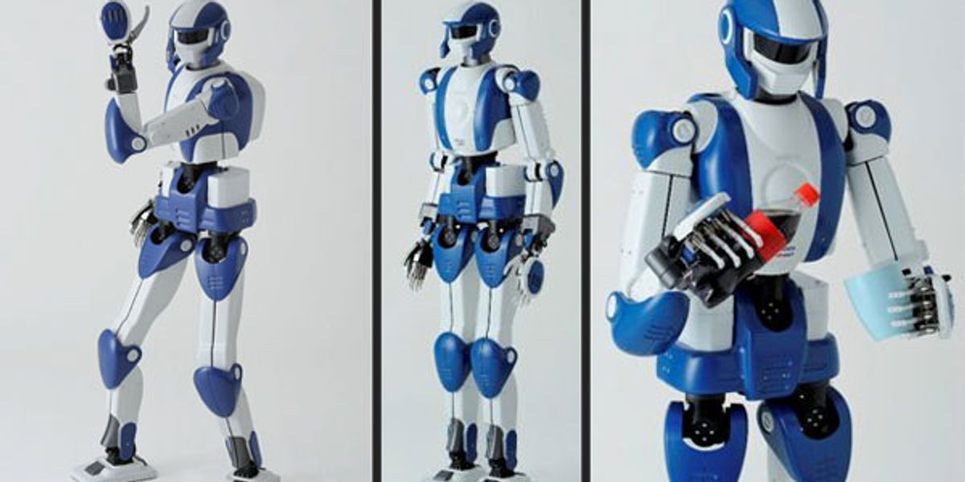
Introduction
Humanoid robots
More and more ubiquitous
Many DOFs, underactuated
Models are complex, need simplifying assumptions
In this project:
Walking is based on the LIP dynamics: control CoM-ZMP system, footsteps as constraints
We add a RL-trained agent to modify footsteps to react to external disturbance forces and terrain inclination

Slide 5



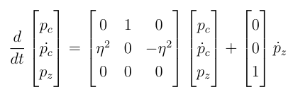
Introduction
LIP Dynamics
Linear model obtained assuming that
  Center of mass is at constant height:
  Internal angular momentum is constant:
Uses ZMP to control CoM + dynamic extension

Slide 6
Introduction
IS-MPC
Extension to classical MPC that includes stability contraints
Uses LIP model for prediction
  Uses ZMP to control CoM
  CoM position and velocity and ZMP position as state
  ZMP velocity as control input (dynamic extension)
Footsteps are used to generate constraints for support polygon
Formulation includes constraints on boundedness of CoM trajectory w.r.t ZMP trajectory
  If these constraints are satisfied , the dynamics is stable
Fixed timings for single and double support phases
    Reference paper considers them variable

Slide 7
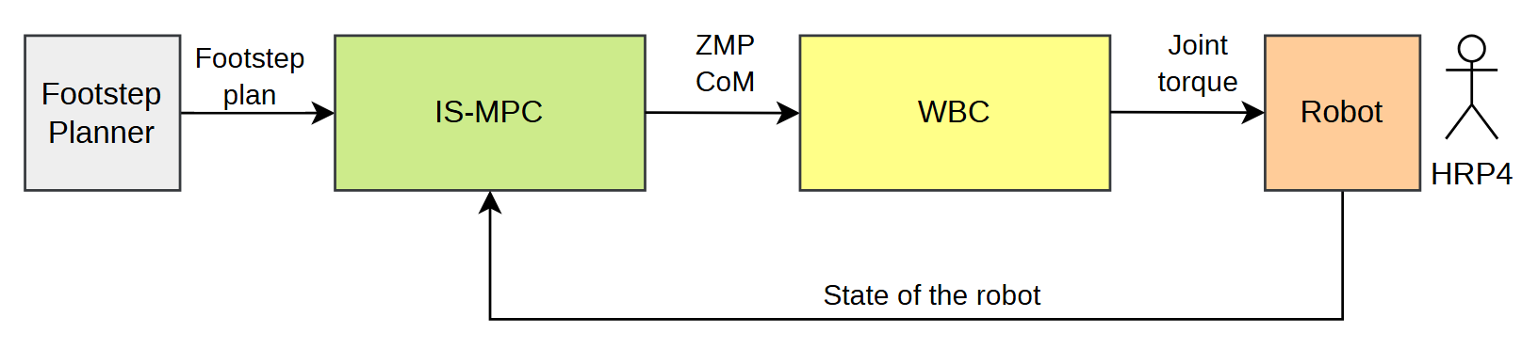

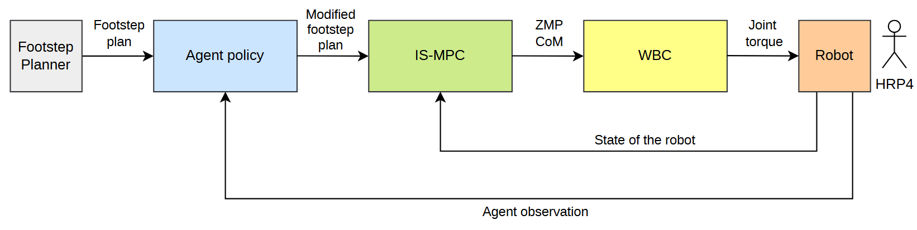
Introduction
Reinforcement Learning approach
IS-MPC prediction model is not accurate in the presence of high disturbance forces and terrain inclination
Augment the scheme with a RL-trained agent which displaces the footsteps to make the robot keep balance

Slide 8
RL approach
PPO – On Policy Algorithms
Act according to the current policy while collecting data (Roll-out)
Process data to compute the Advantage (used in loss function)
Update the policy network w.r.t. PPO Loss to maximize the Expected Return
Repeat
When enough data is collected the simulations are paused and network is updated
Advantage is used to compute part of the PPO Surrogate Loss
Then Roll-outs are restarted and simulations are resumed
This process is repeated for a large number of episodes
Our implementation runs 16 parallelized environments each Roll-out

Slide 9
Actor-Critic algorithm
The advantage function express how good it is to take a certain action a in state s w.r.t. the other actions
It is defined as:
Estimated by a NN
A(s,a) = Q(s,a) - V(s)
Expected return from taking action a in state s
Mean expected return of the policy in state s
It is used to compute an estimator of the policy gradient
Gradient ascent algorithm to update the policy network (actor component)
V(s) estimated by the critic component of the neural policy
V(s) estimation updated according to a squared-error loss w.r.t. a V(s) target

Slide 10
RL Curriculum Learning
Curriculum Learning
Start by training the agent on simple environments
Gradually increase the difficulty of the environment in levels (not included in reward function)
Difficulty corresponds to range of possible terrain inclinations
  Range [3.4°, 6.8°] * level / 100
An agent starts from 0 points.
    It is awarded 2 points for successfully completing a foostep plan with no failure.
    1 point subtracted on any failure
  An agent levels up when it accumulates a total of 6 points

Slide 11

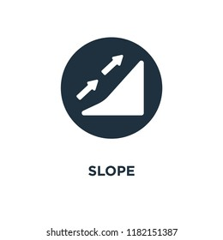
Disturbances
External forces
Ground Slope
Random external forces between 30 and 87N are applied to random bodies of the robot (torso, body, feet)
The ground has a slope (both in x and y direction) that is not modelled in MPC

Slide 12
GENERAL FRAMEWORK

Slide 13

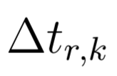






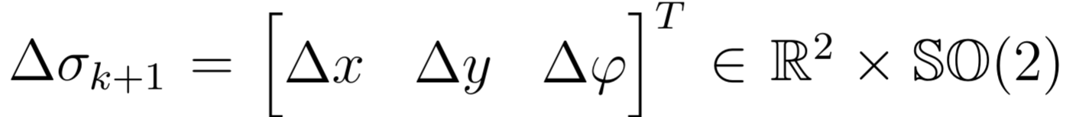

Observations
Observations
Support foot encoding
Remaining time in swing
CoM position and velocity
ZMP position
CoM reference velocity
ZMP reference position
Angular momentum
Next footstep position
Next footstep reference position
All components of the state are relative to the current support foot
Displacements given in this form

Slide 14

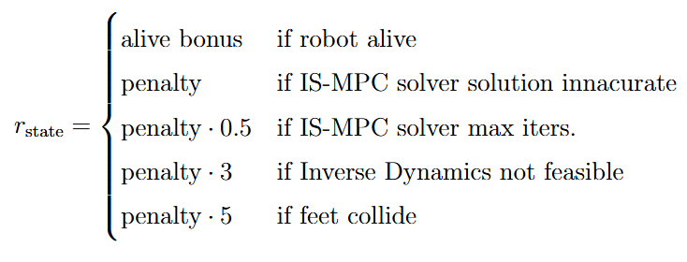
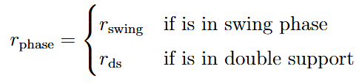
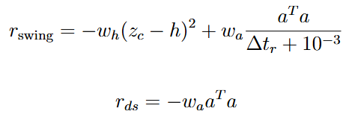
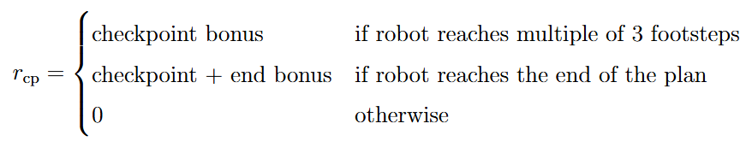
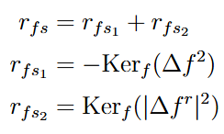


Rewards
Reward function given to the Agent

Slide 15
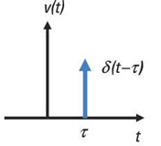
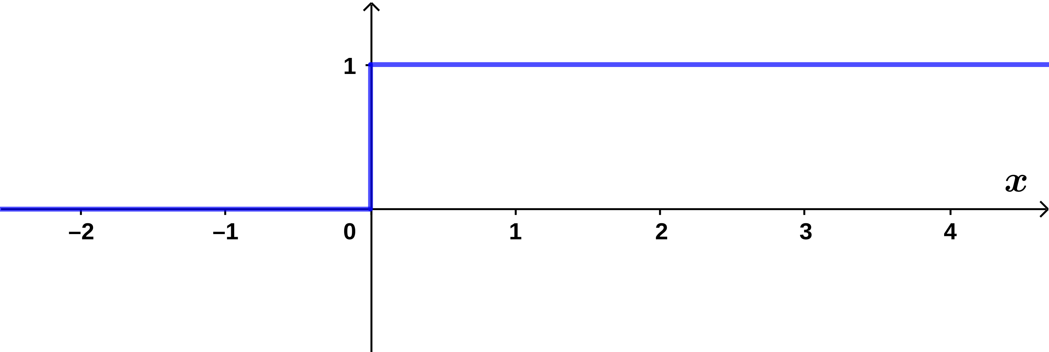
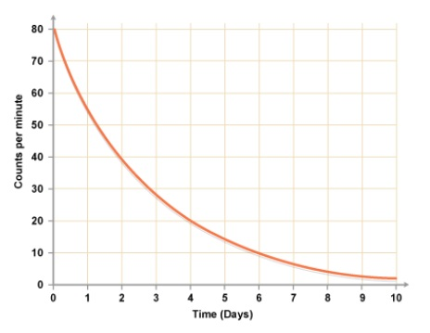
Differents Approaches
Approach 1
Only the next foostep is displaced
Approach 2
The whole plan is displaced
Approach 3
Successive footsteps are displaced with a given scaling factor
Approach 3 – extendension
Same as approach 3, but the scaling parameter is learned

Slide 16
Different Approaches
Different approaches to footstep displacement
Approach 1: displace only the next footstep.
Approach 2: displace the whole plan.
Approach 3: fully displace the next footstep, then geometrically scale displacement of successive footsteps.
Saturations are considered on the maximum displacement of the next footstep to ensure it stays feasible after displacement (for all agents).
Since in PPO actions are sampled from a Gaussian policy, in general we expect to see some displacement even when no disturbance is present, even on a very well trained agent.

Slide 17
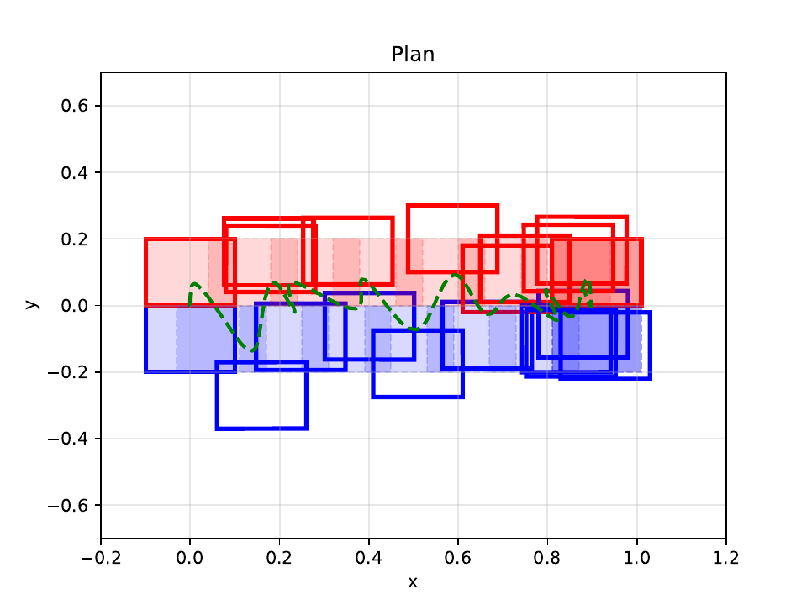
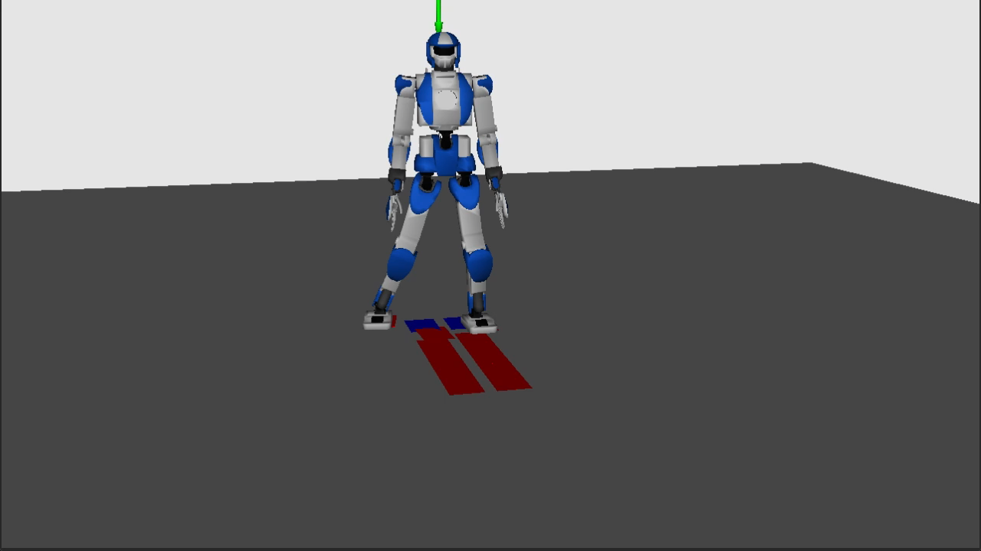
Footstep displacement
Approach 1
Only the next foostep is displaced
Little displacement, easily track the nominal footstep plan
Displacement might make the plan unfeasible, especially when caused by external forces or terrain inclination
  Feasibility of current displacement depends on future (unknown) actions!

Slide 18
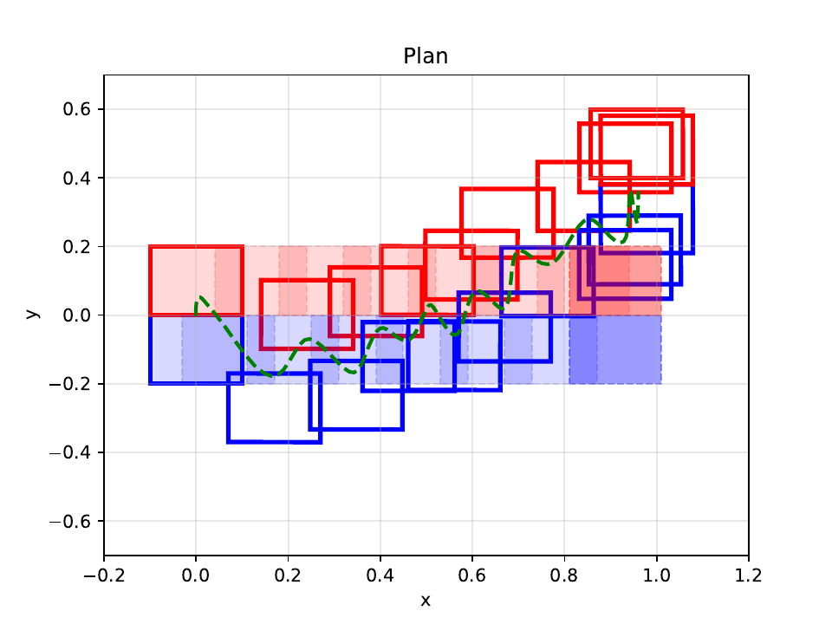

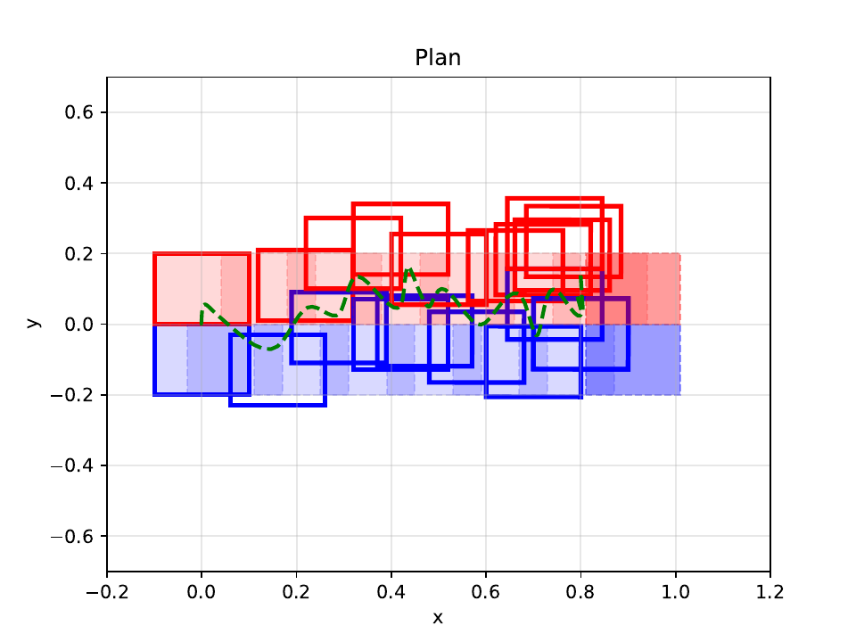
Footstep displacement
Approach 2
The whole plan is displaced
Displaced plan is feasible if both the original plan and the current displacement are
Displacements accumulate, the robot easily strays from the nominal plan
  Can add appropriate reward to encourage better tracking, but this doesn't always work
Notes:
We assume that the nominal plan is always feasible in nominal conditions (no forces, no inclination)

Slide 19

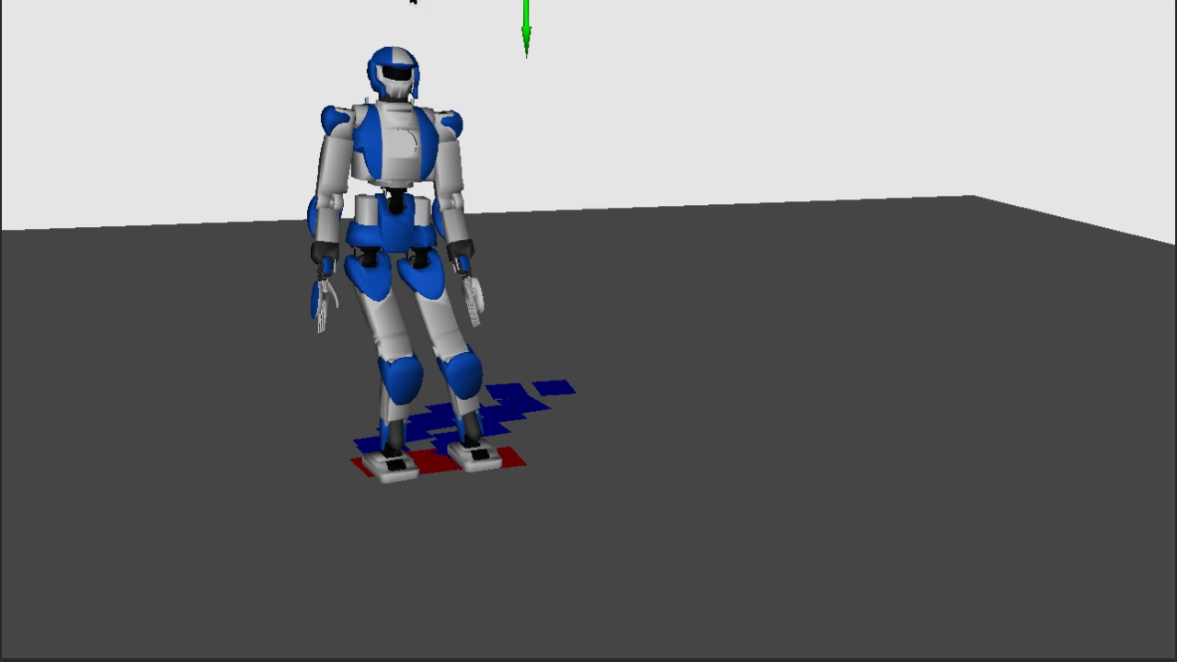
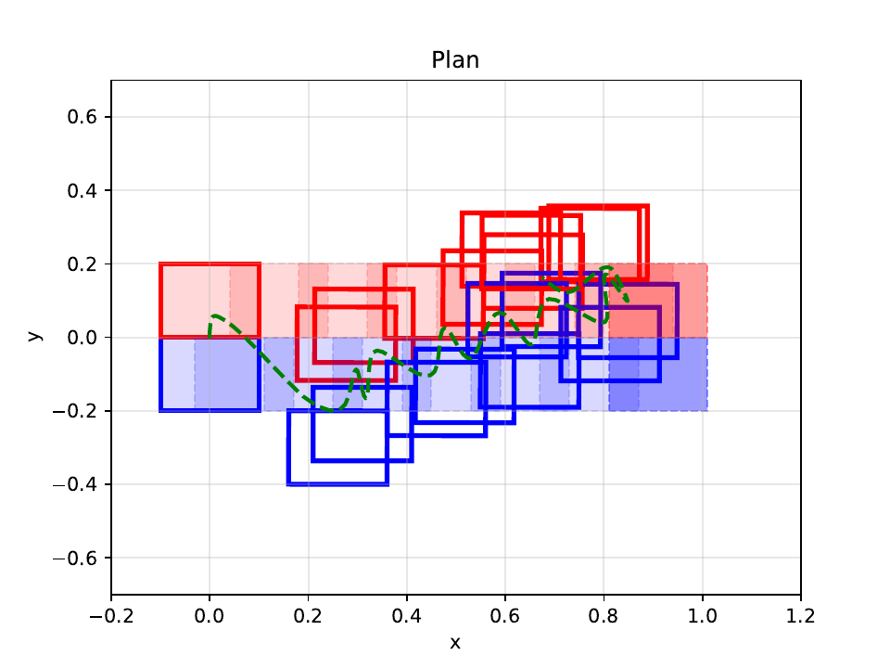
Footstep displacement
Approach 3
Trade
Tradeoff between approaches 1 and 2
The first footstep is completely displaced, for the successive ones the displacement is geometrically scaled by a fixed factor (hyperparameter)
Better tracking that approach 2, displacements are feasible with higher probability than approach 1.

Slide 20


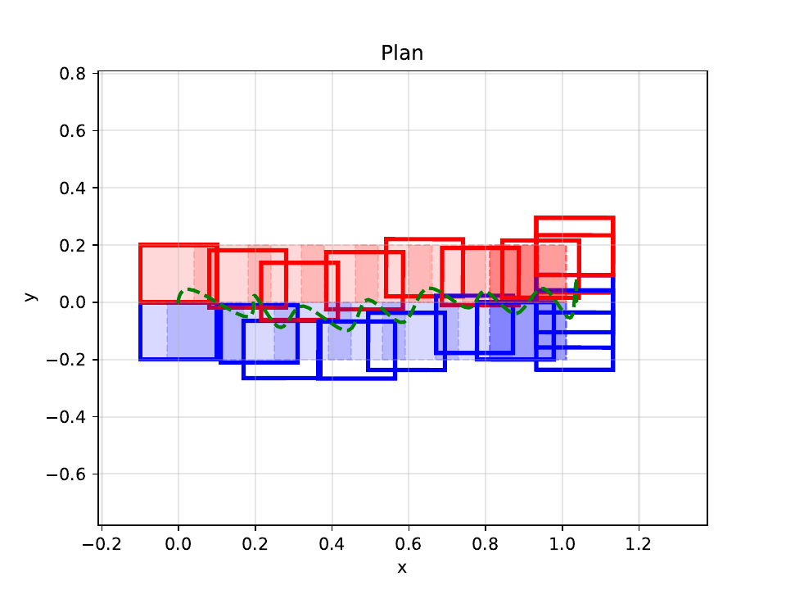
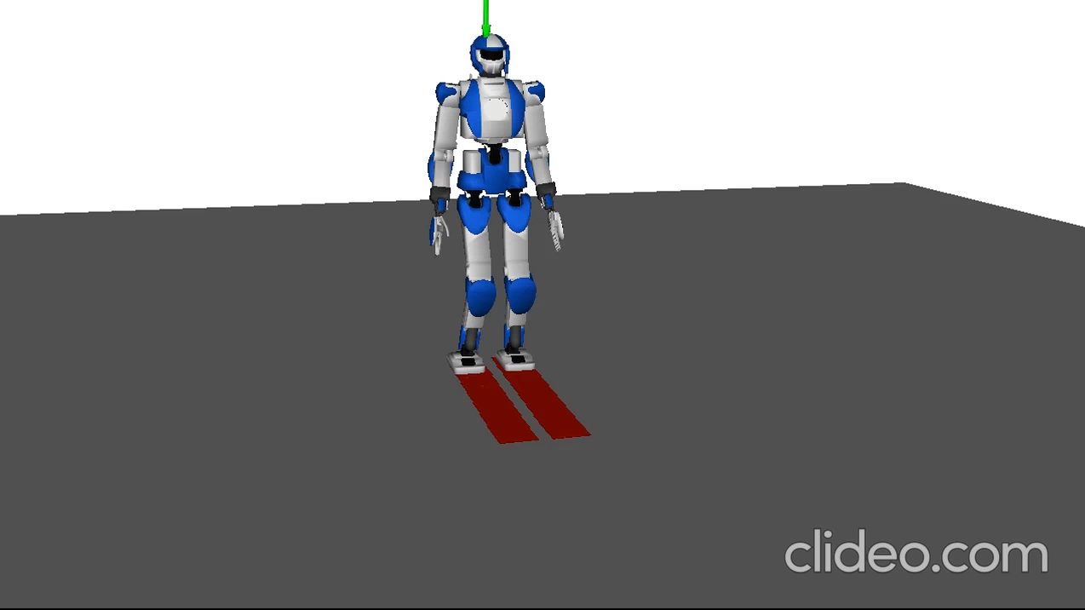
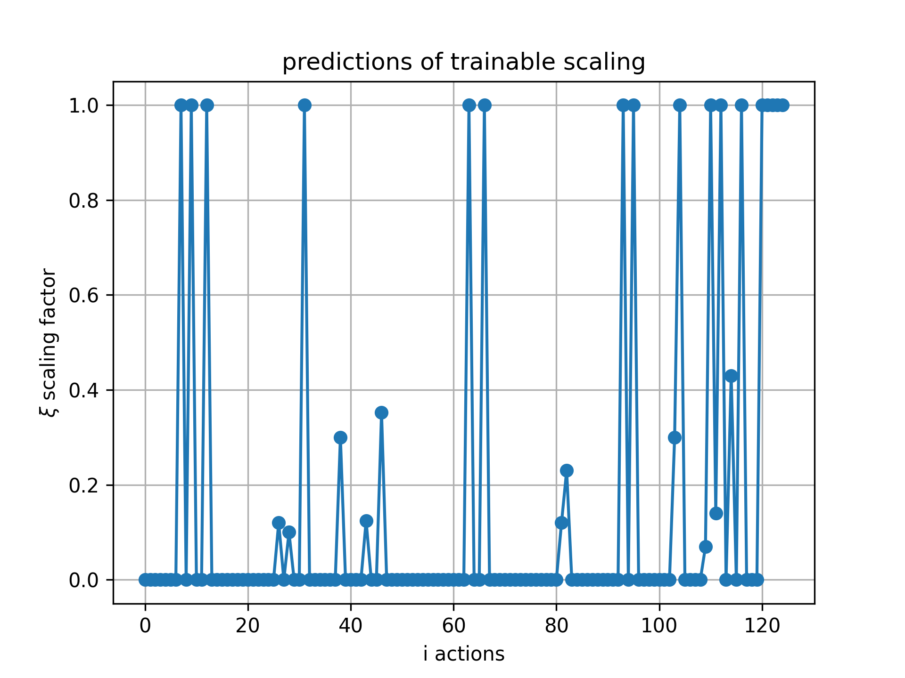
Footstep displacement
Approach 3- Extension
Trade
Approach 3 with the scaling parameter that is learned.
Nominal Conditions: displace only 1st footstep

Slide 21
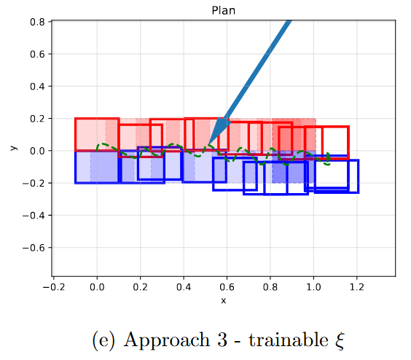
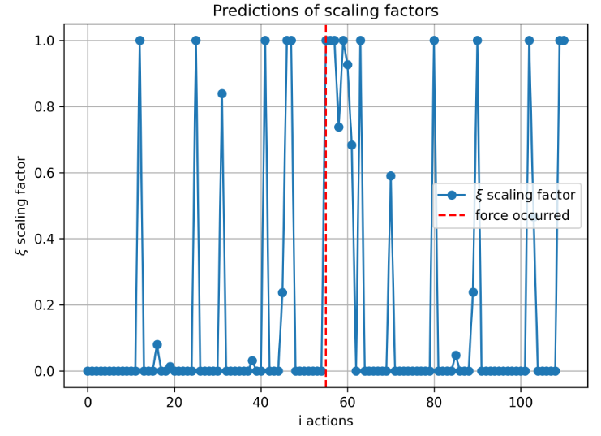
Foostep displacement
Only external forces
Learned to modify all the plan if it is needed to recover dynamical balance after force disturbances
More uncertain behavior if ground slope is introduced

Slide 22



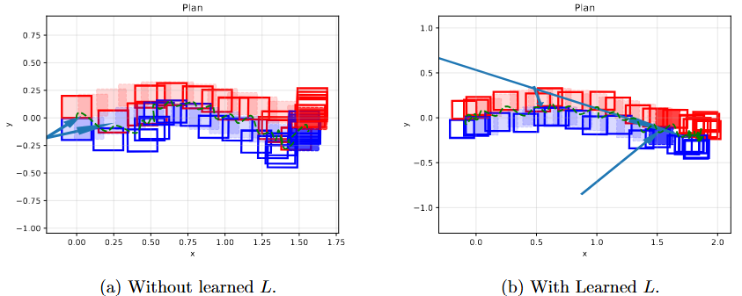
Learning Angular Momentum
Idea: Learning to reproduce a Desired Angular Momentum about the contact point
We get an Angular Momentum reference performing a simulation in nominal conditions with only IS-MPC
augmented agent
observation space
Promoting tracking with the reward term:
better reference reproduction capabilites
Notes:
Questa soluzione temporanea: estensione con MPC che pianifica momento angolare

Slide 23
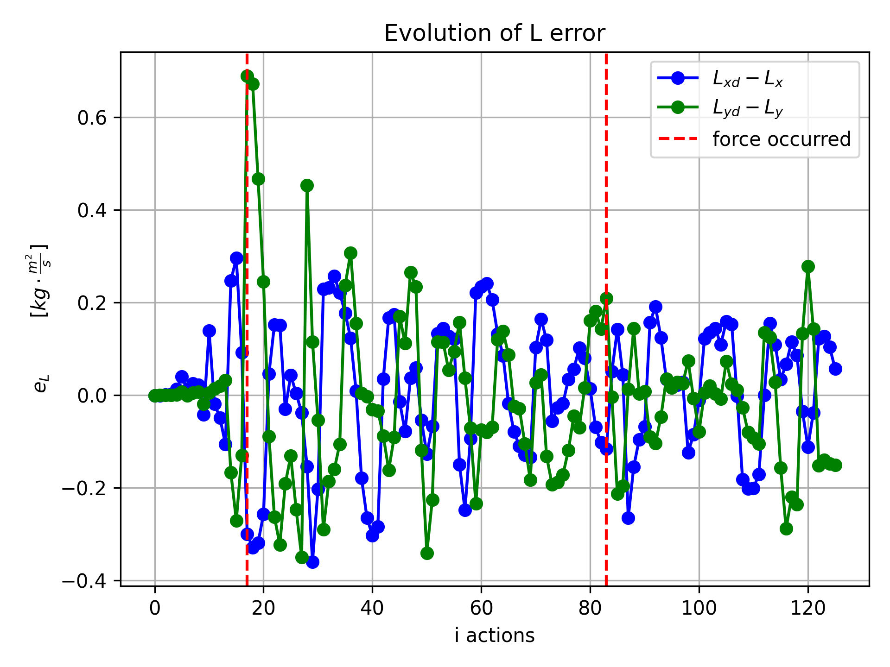
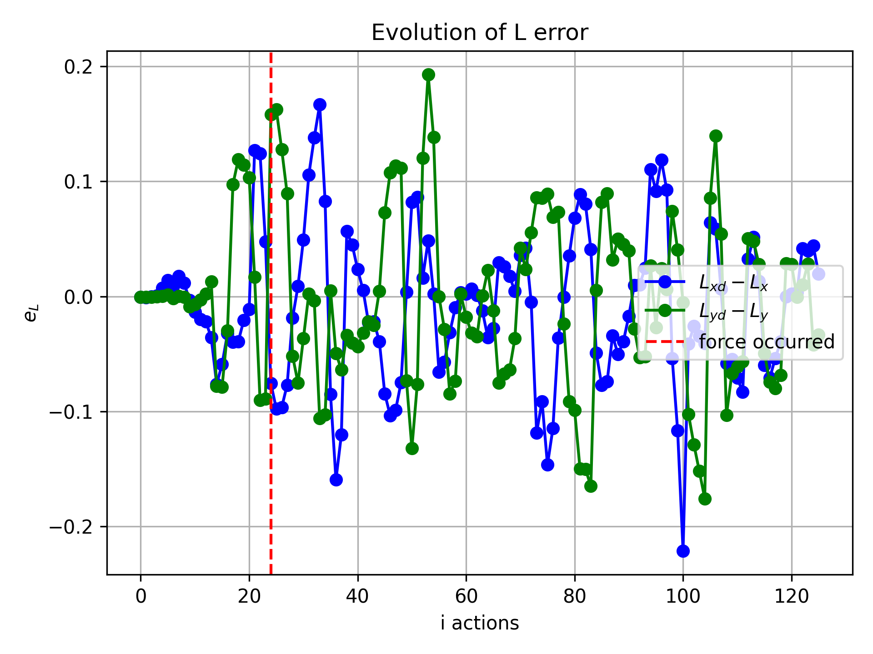
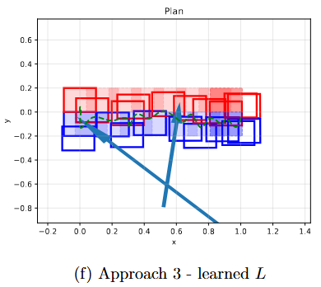
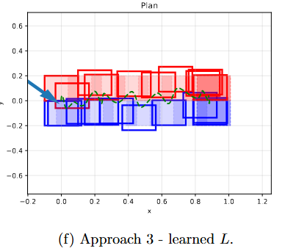
Learning Angular Momentum
Idea: Learning to reproduce a Desired Angular Momentum about the contact point
Spikes in the error as an external force occurs
not so effective in presence of ground slope

Slide 24
SIMULATIONS

Slide 25
Simulations
Setup
Sampling time 0.01s
IS-MPC prediction horizon to 150 samples (1.5s)
Policy is a MLP, two hidden layers of 64 nodes each and tanh activations
Saturation on total displacement of the next foostep is set to 0.2m
Only approach 3 is shown for brevity, scaling factor set to 0.9
  The report includes each simulation with all three approaches
Random forces between [30, 87] [N] in magnitude, applied with 3% chance each step to a random part of the robot between torso, body and feet
Feet collision is considered a failure, same as crashing MPC or Whole Body Controller solvers
Notes:
Mention that we have shown sim1 (straight line, no forces no inclination) when showing each approach, here skip directly to the interesting bits.
Simulations with other displacement strategies are in the report

Slide 26
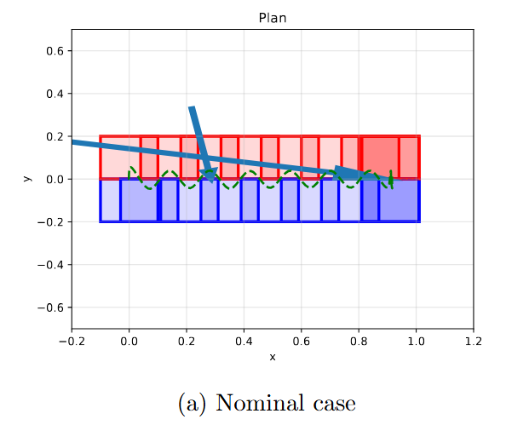
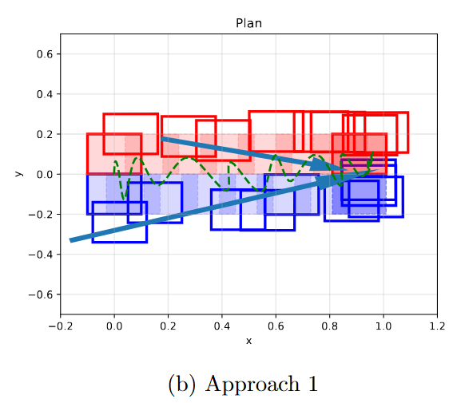
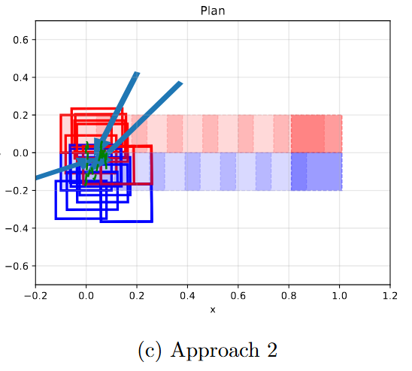
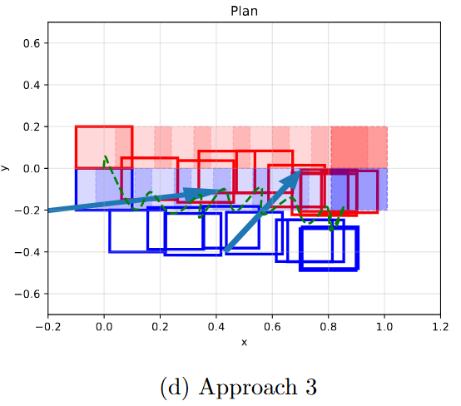
SImulation Results
Subtitle
subsubtitle
Nominal case
Only external forces

Slide 27
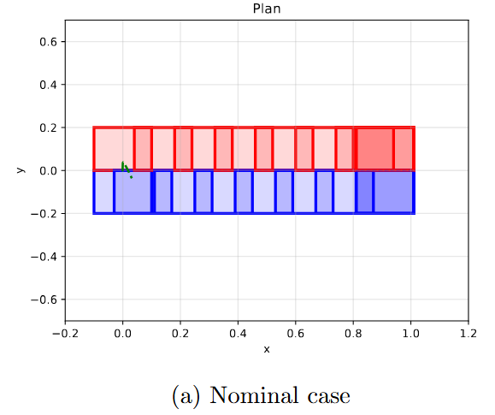
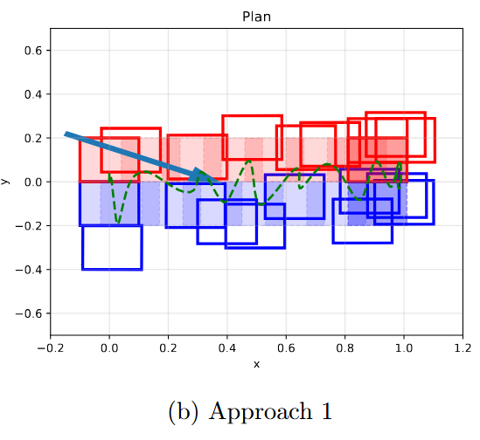
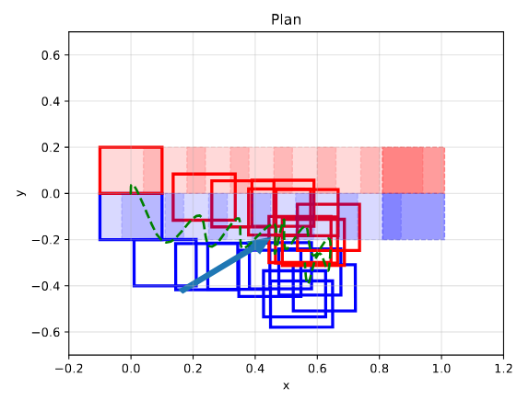
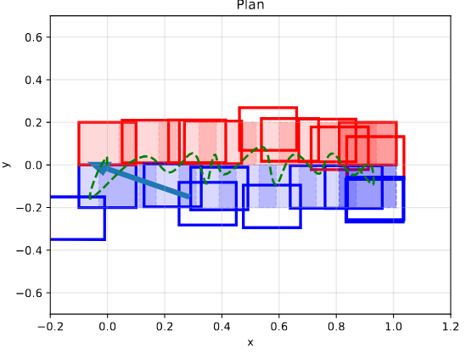
SImulation Results
Subtitle
subsubtitle
Nominal case
External forces + Slope Ground

Slide 28
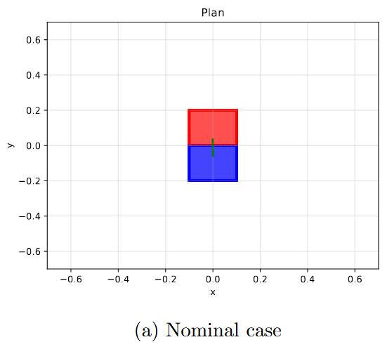
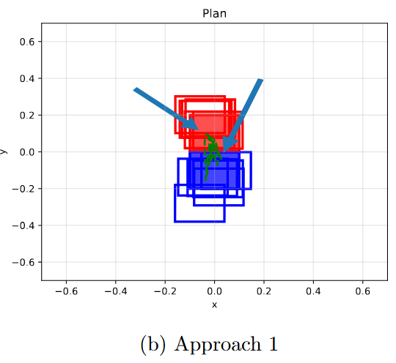
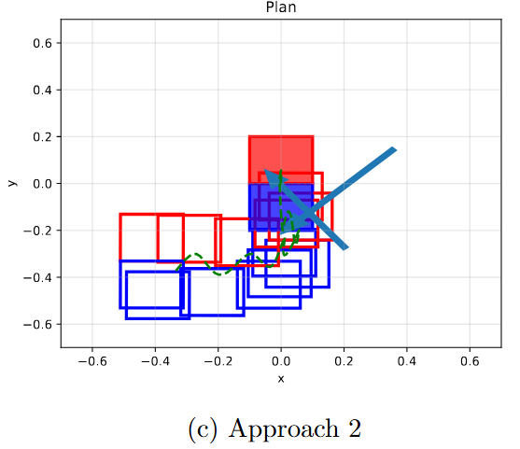
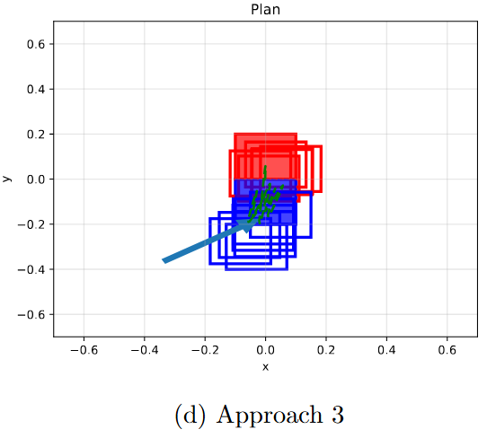
Simulation Results
Subtitle
subsubtitle
Nominal case
External forces + Slope Ground

Slide 29
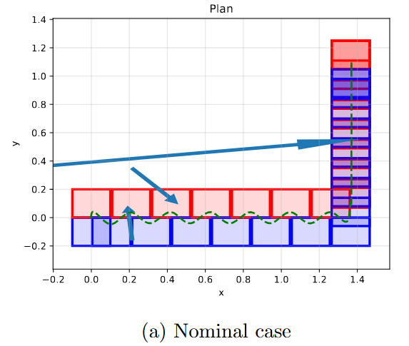
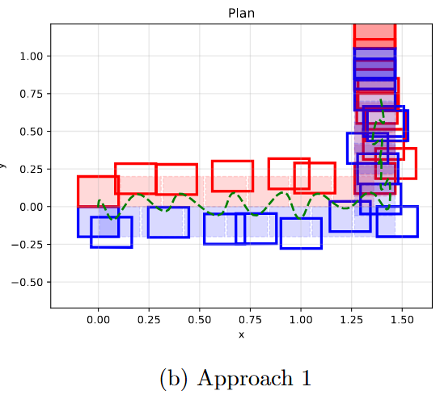
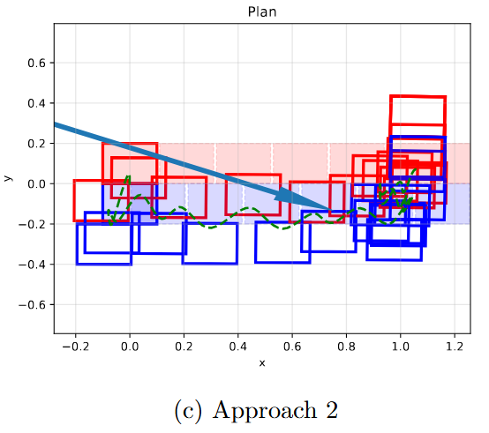
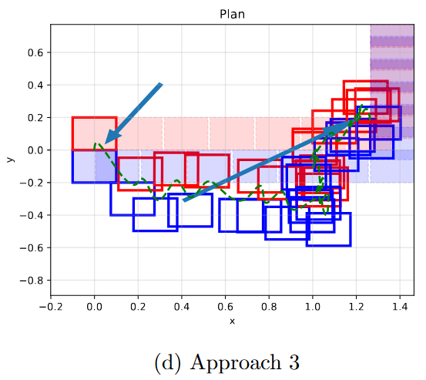
Simulation Results
Subtitle
subsubtitle
Nominal case
External forces + Slope Ground

Slide 30
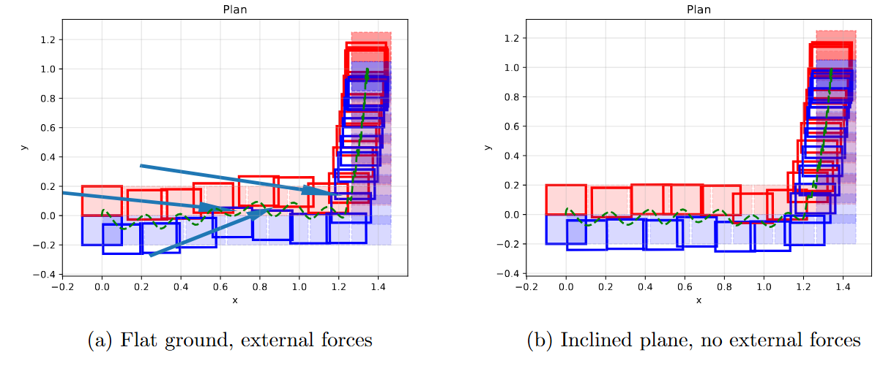
SImulation Results
Subtitle
subsubtitle
External forces + Slope Ground
Approach 3 with feet saturation to prevent collision

Slide 31
Simulations
Sim 2 – Walking on the spot, with forces, no terrain inclination
Trade
Nominal case (IS-MPC only)
Notes:
We show the robot falling, forcing IS-MPC to take suboptimal actions (with unsatisfied the stability constraint) to clearly show that the controller is failing.
Otherwise the solver just crashes and the episode starts again and it's hard to distinguish from an end of plan

Slide 32
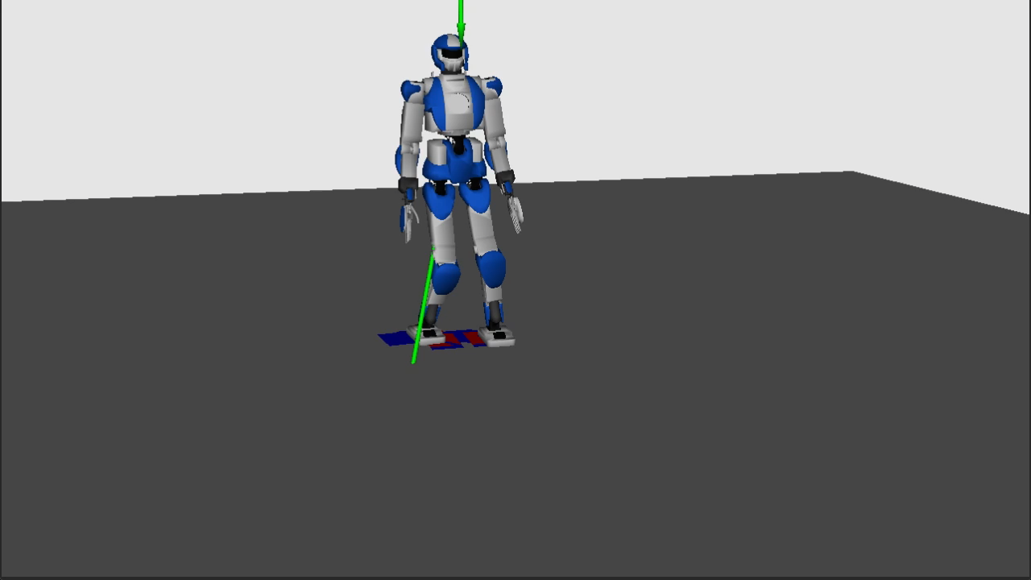
Simulations
Sim 2 – Walking on the spot, with forces, no terrain inclination
Trade
Approach 3

Slide 33
Simulations
Sim 3 – Straight line trajectory, with forces and inclination (x: 3°, y: 1°)
Trade
Nominal (IS-MPC only)

Slide 34
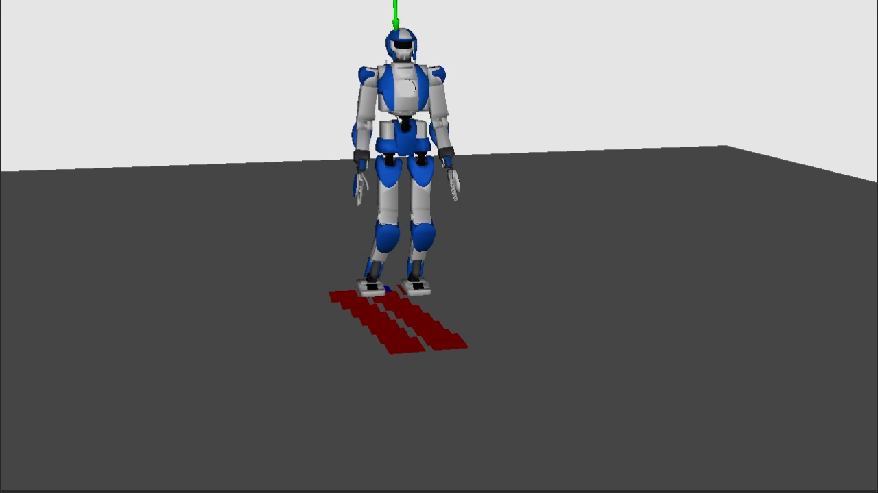
Simulations
Sim 3 – Straight line trajectory, with forces and inclination (x: 3°, y: 1°)
Trade
Approach 3

Slide 35


Simulations
Sim 4 – Validation trajectory, with forces, no inclination
Trade
Approach 3
Most common modes of failure are feet collision or solver failure when changing direction: the agent is not generalizing well
Trade
Notes:
Mention that validation plans are also longer than training plans

Slide 36
Simulations
Sim 5 – Validation trajectory, with forces, inclination (x: 3°, y: 1°) and saturated actions
Trade
Approach 3 – Trainable scaling factor and learned L
Actions are saturated to prevent feet collision and for max. displacement, model trained from scratch

Slide 37




Simulations
Sim 5 – Validation trajectory, with forces, inclination (x: 4°, y: 1°) and saturated actions
Trade
Approach 3, trainable scaling factor and learned L
actions saturation allows to walk sideways
more involved
scaling factor predictions
if ground is tiltedd

Slide 38
When To Use The Agent?
Use the agent only when is needed
Trade
The agent will always modify the plan
  But if well trained, the displacements will be close to zero when in near-nominal conditions
It is interesting to find a way to "turn-off" and "turn-on" the agent only when a force is applied or the terrain is inclined.
How to detect if there are perturbations in the environment?
Hybrid Gaussian- Bernoullian decision policy
Energy Observer

Slide 39





Energy Observer Derivation
Energy observer for perturbation detection
The energy of the LIP dynamics can be monitored with a residual
If the residual is above a threshold, something is perturbing the model and the Agent must take actions
Notes:
Plots show multiple simulations (each colored dotted line is a different episode)

Slide 40


Energy Observer
Energy observer for perturbation detection
Notes:
Plots show multiple simulations (each colored dotted line is a different episode)

Slide 41

Energy Observer Behaviour
Final displacement
General displacement from original plan
Notes:
No inclination, otherwise the residual would be always active, only forces
Two

Slide 42



Hybrid Policy
Hybrid Gaussian-Bernoullian policy to decide if acting or not
Trained to provide predictions both on displacement and on a binary decision
Hybrid action space: continous and discrete
The agent learns to disable corrections to better reproduce the reference
Interventing just in the presence of external forces to recover balance
no ground slope here
Notes:
Plots show multiple simulations (each colored dotted line is a different episode)

Slide 43

Hybrid Policy
Hybrid Gaussian-Bernoullian policy to decide if acting or not
probability of acting increases as a force occurs
behaves as a Neural Residual
Notes:
Plots show multiple simulations (each colored dotted line is a different episode)

Slide 44



Final comparisons
Slope comparison:
Hybrid Gaussian-Bernoullian policy
VS
pure IS-MPC
Slope comparison:​
Approach 3 scaled 0.9
VS
pure IS-MPC
Forces comparison:​​
Approach 3 scaled 0.9
VS
pure IS-MPC
Notes:
Plots show multiple simulations (each colored dotted line is a different episode)

Slide 45
CONCLUSIONS

Slide 46
Conclusions
Recap of our work
Trade
We augmented a MPC-based control scheme for humanoid locomotion with a Reinforcement-Learning based agent.
The agent is trained with the PPO algorithm, and displaces the footsteps of the plan to reject disturbances and keep balance on inclined terrain.
We explored three different approaches to displacement:
  Only the next footstep: displacement may invalidate the plan. Very good tracking, but poor response to disturbance forces.
  Whole plan: Saturated displacements are always feasible, but poor tracking.
  Scaled: best of both worlds.
    Better performance when scaling parameter is part of the action space

Slide 47
Conclusions
On generalization
The agents do not generalize well to new footstep plans:
    It's hard to modify the ZMP/CoM relationship by just moving footsteps (thus only changing MPC constraints)
    IS-MPC assumes fixed timings for single and double support phases, in the reference paper they are computed by MPC
  Saturations to prevent feet collision lead to better generalization and behaviour in general, by effectively reducing the action space
    Less failures -> more regular learning
    The agent doesn't know about saturations, but better learns that displacement should be near zero in general, greater only with disturbances
  We also looked to methods for deciding when to apply the action, to displace footsteps only when strictly necessary, more precise than just saturating actions

